Slide 1
Poster Design
By: ASTHA KARKI

Slide 2
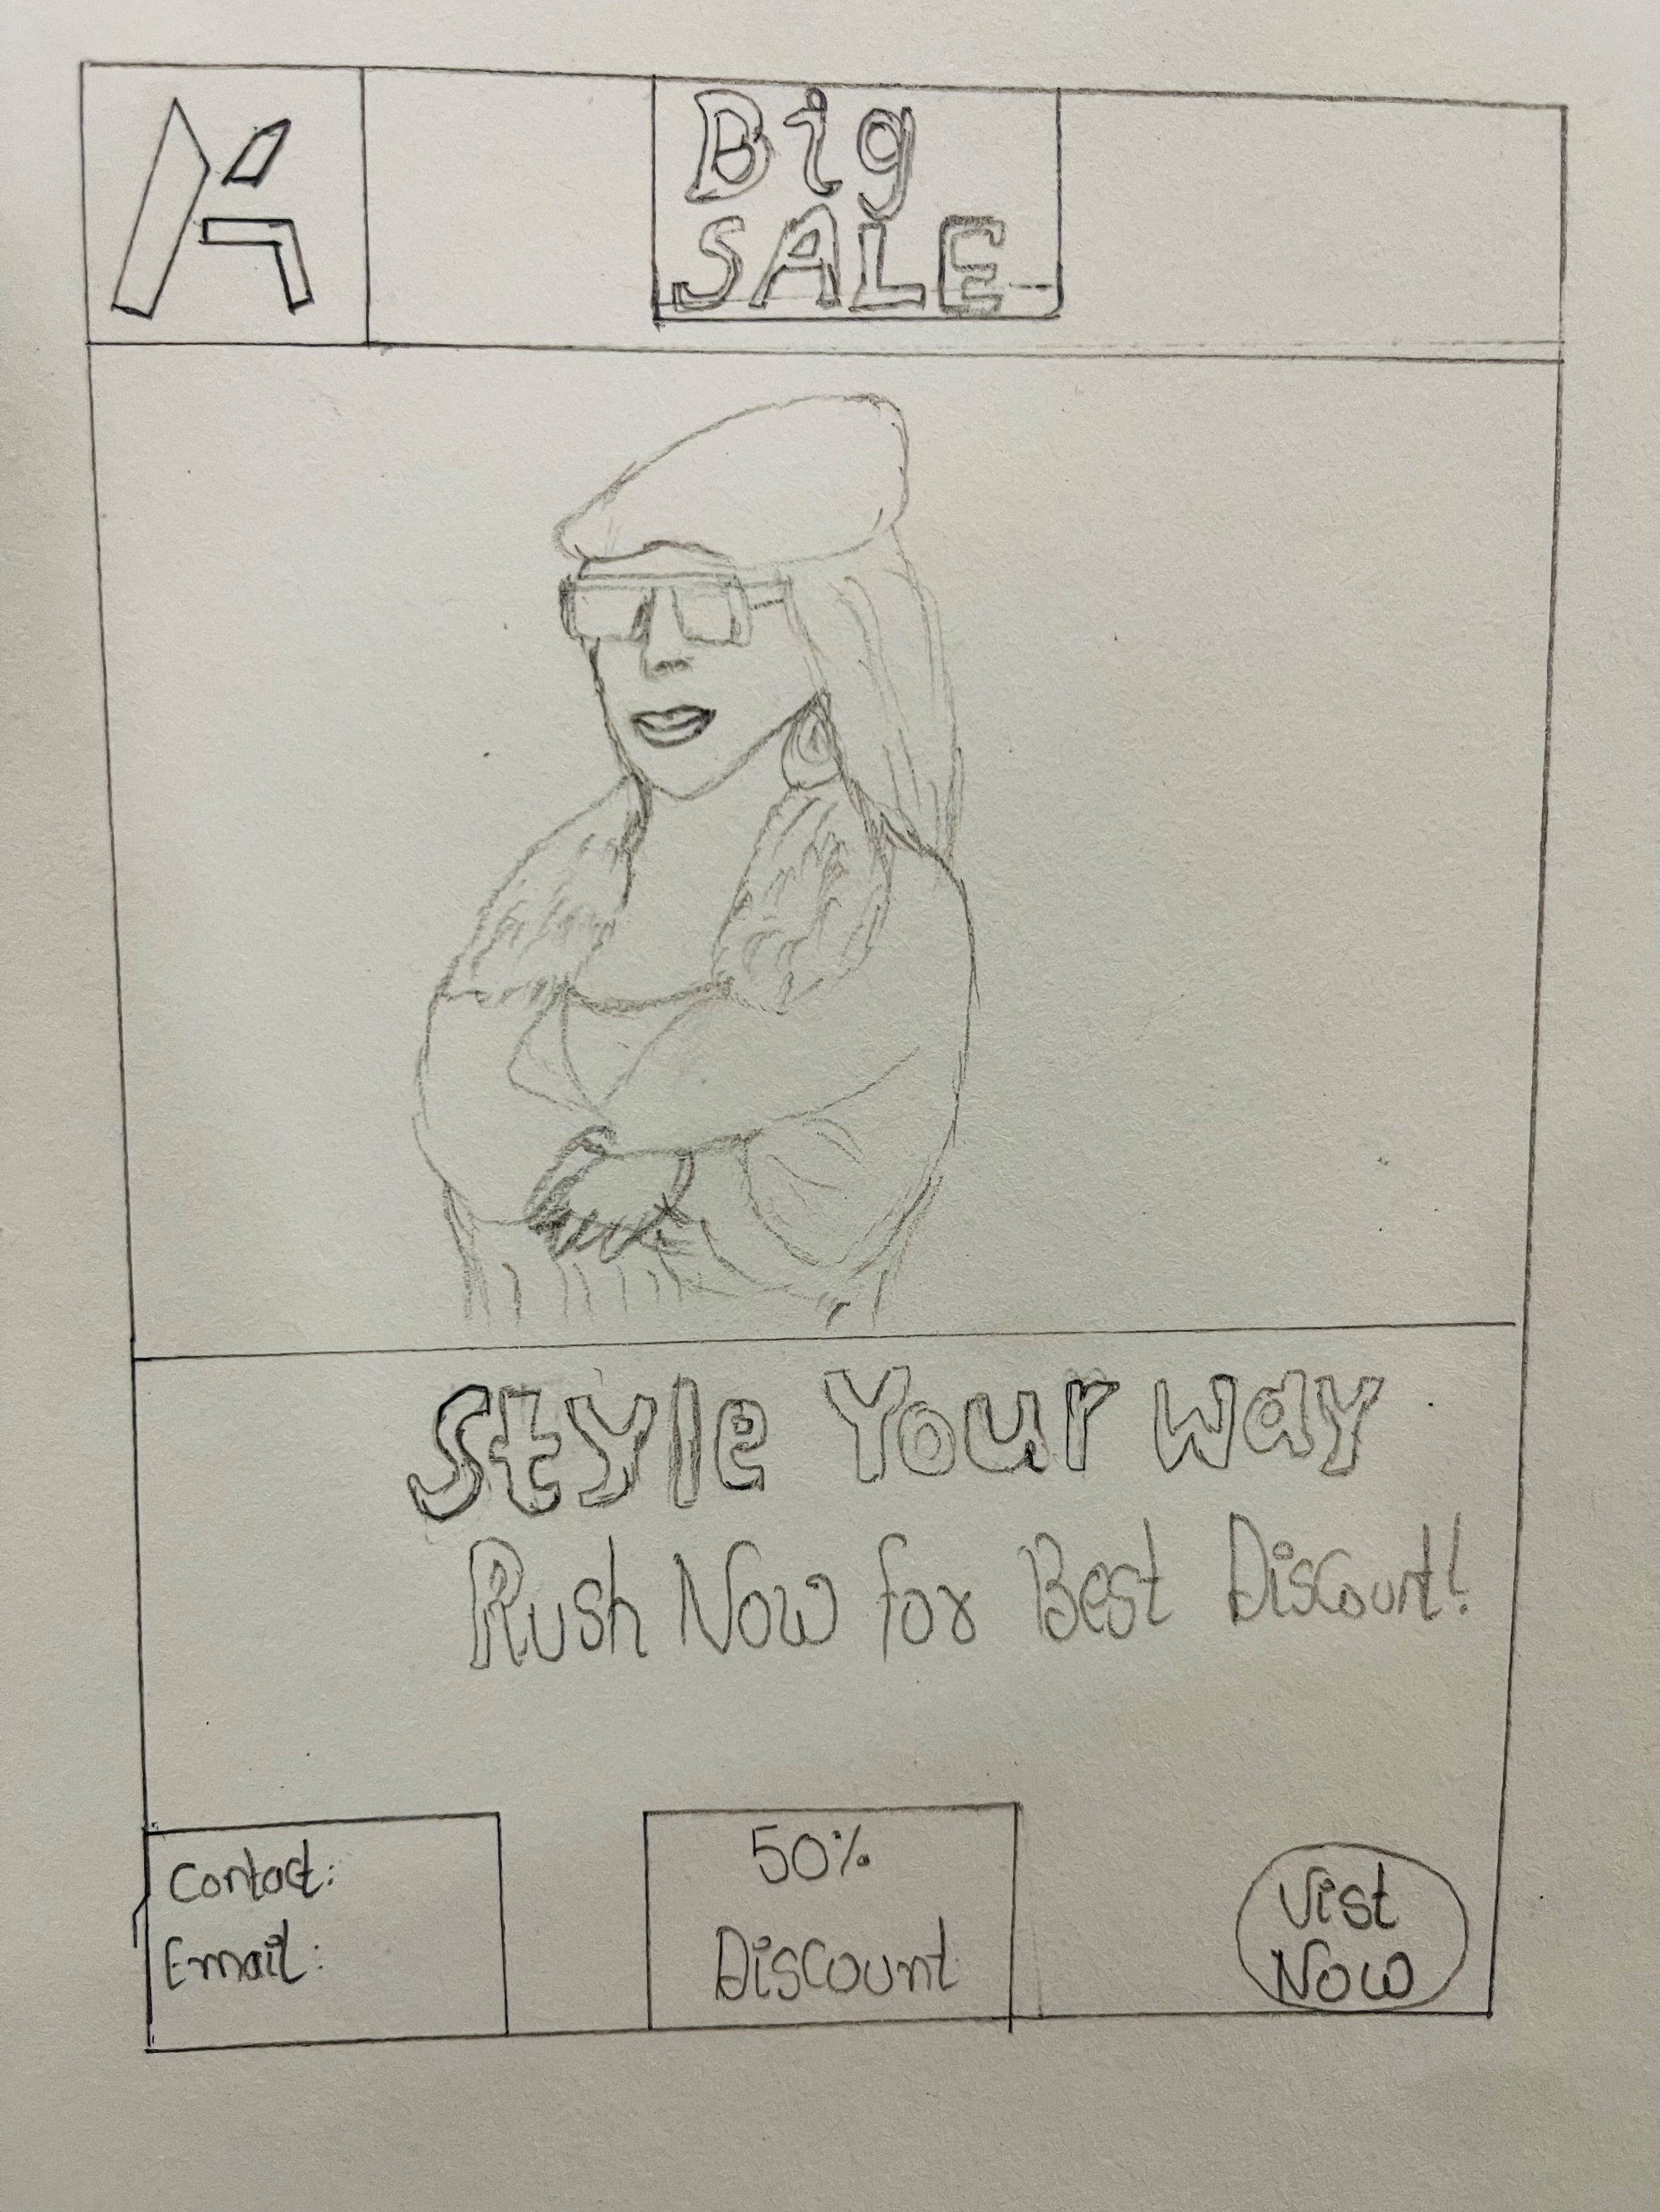
Sketch

Slide 3
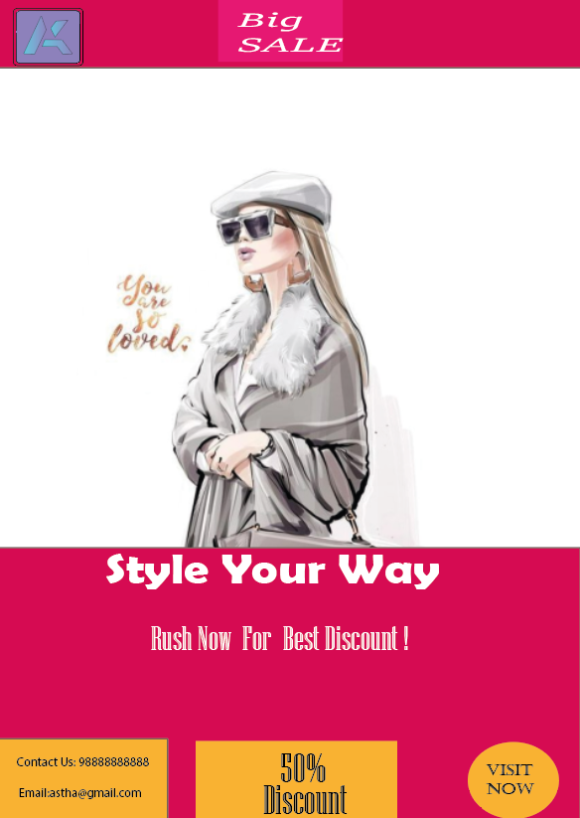
POSTER

Slide 4
FASHION STORE
A Fashion store is a online clothing store that advertises its global production while maintaining a distinct sense of style.
Details
Poster is about sale in fashion store.
In poster you can get information about big sale in fashion store .

